Slide 1

Data Warehouse Project
Advanced Data Management Technologies
08/01/2021
Fanti Coelho Lima Rachel
Porras Galindo Johan Leandro

Slide 2


The company
The app
The process
Cambly Inc.
Company Founded: November 2, 2012
Founders: Sameer Shariff, Kevin Law
Is an online platform where people from all over the world can have tutoring with English native speakers.
Business Process
Sales
Tutoring

Slide 3
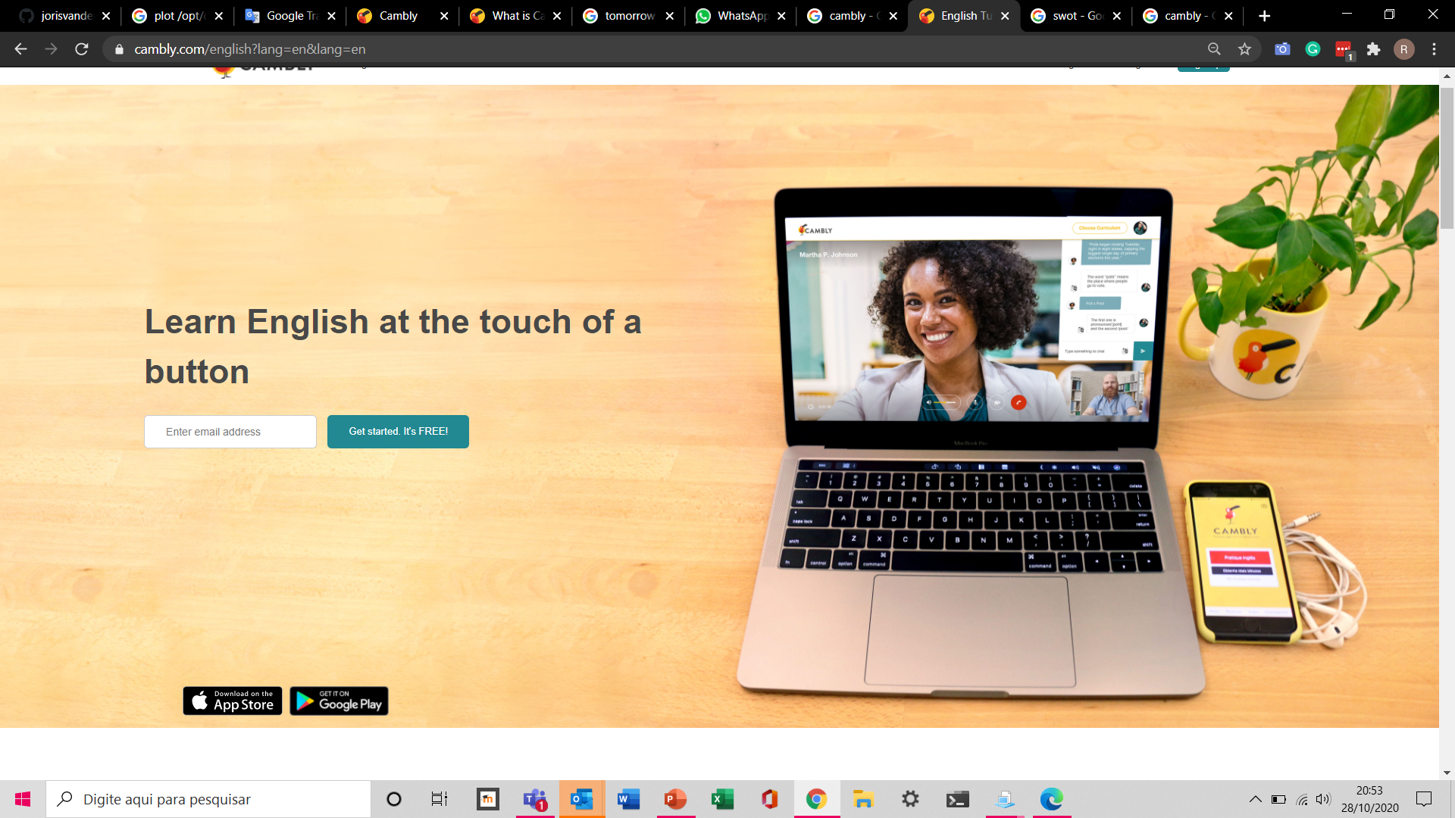
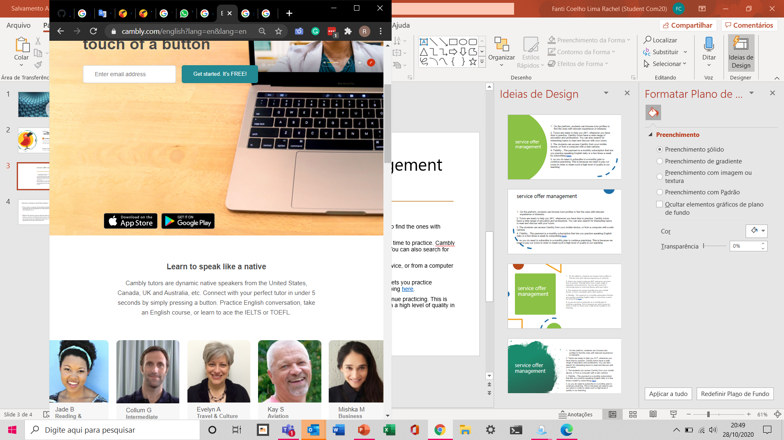
How does Cambly work?
On the platform, registered students can video chat with English tutors from different regions with different accents. They browse tutor profiles to find the ones with relevant experience and interests.
On the company’s web site are available two different services for a monthly fee: tutoring and interactive language courses.
There are tutors available 24 hours, 7 days in the week. The students can see each tutor’s class schedule and their available time. They can speak with as many tutors as they'd like up until your minutes run out.
There are 300,000 students of all ages spread across the world, such as Brazil, Saudi Arabia, China, South Korea, Japan, Russia and Turkey.
There are more than 3,000 tutors registered who have a wide range of education and professions.
The students can search for interesting topics to read or discuss with the tutors if they want.
Materials and classes of different levels and themes are offered, according to the needs of each student, such as proof of proficiency, referring to business, studies, literature, healthy, life etc.
All classes are evaluated by students. The classes are recorded and saved in the student's profile so that they can review and study the main points.
The student can obtain a certificate at any time with the total hours of classes.
Students can choose between different subscriptions that differ in length (monthly, quarterly, annually), duration of each video chat (15, 30 or 60 minutes per day) and frequency of video chat (2, 3 or 5 days per week). Subscription prices can range from 40€/month to 271€/month
Every data is collected through the web site or the apps (IOS/Android)

Slide 4
Management decisions
Management want to better understand:
The most significant decisions have to do with:
How to attract as much paying users as possible?
What convinces the typical trial users to buy a plan
Subscriptions pricing (calibrated according to the different economic regions)
Promotion to win a constant number of paying users and to localize old ones, in order to ensure a healthy ecosystem and high level of service delivering
User satisfaction (improvements, fidelity etc)
Bandwidth utilization (how much, in which regions, optimizations based for example on service utilization in different time zones)
Incentives to increase the number of tutors and to retain the best ones
Development of new courses and new ideas that attract and retain customers
The typical user behaviour based on the several dimensions and attributes
The sales behaviour through different channels
The sales​ behaviour acrost time
Identify most valuable customers
What types of courses attract the most

Slide 5
Motivations for the development of a DW
A DW allow the professionals of the company understand better your market and business, propitiating data-based decision making and increasing the competitive advantage.
It supports the managers to better understand the points mentioned previously, identifying users’ needs and new opportunities, allowing the company to respond more quickly to changes.
A completer and more consistent store of data and systems with more scalability are required due to the large amount of data involved, the growing increase in users and the continuous evolution of the system.
This technology allows the company to host new applications and technologies without redesigning the whole system.

Slide 6
Business questions
Sales
What is the average spending per student?
What is the profit per period per student?
Which teachers collect the most?
What is the percentage of sales to natural persons and companies (juridical persons)?
What is the percentage between adults and children?
In which country and continent are there more sales? (countries of origin)
What are the price ranges for services in the main countries and continents?
At what time of the year are there more sales?
Is there a need to create specific price actions for segments of the public (companies, adult, kids, teenagers)?
What is the age group of the main customers?
What is the level of proficiency of the main customers?
From which mean (web site, ads, referral .. etc) the sale was made?

Slide 7
Business questions
Tutoring
What are the top 5 most popular courses chosen by the students? Which kind of material they look for?
What are the top 5 best tutors?
Which are the profile of the best evaluated tutors?
How many tutors are selected by students per year?
How many days a week on average are attended by students?
What is the number of Tutoring sessions per week by User and Teacher?
What is the average duration of Tutoring a session by User and Teacher
At which hours, Tutoring are most requested?
What percentage of classes had connection problems?
How many classes occur simultaneously in the app?
What is the average amount of time a teacher and the students stays on Cambly? For what reasons do users leave the app?
How many days a week on average are offered by teachers? And by the best rated?
There were tutors available to attend students at the requested time and online?

Slide 8


Granularity level of the business process
Sales
Tutoring
Sales per customer per tutor per course per promotion per day
Tutoring per customer per tutor per course per day

Slide 9



Development of a DW
BUS Matrix
 | Date | Customer | Student | Tutor | Course | Promotion | …
Sales | X | X |  | X | X
Tutoring | X | X | X |  |  | X
…
Bottom-up approach
Table 1 - Bus Matrix representing the Sales and Tutoring process and the dimensions.
Mixed approach of supply-driven and demand-driven

Slide 10
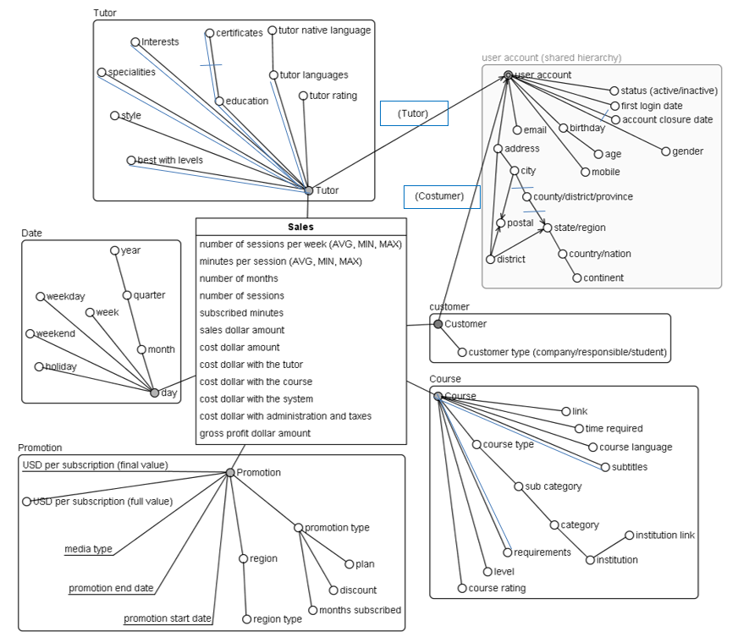
Conceptual DFM Sales Fact

Slide 11
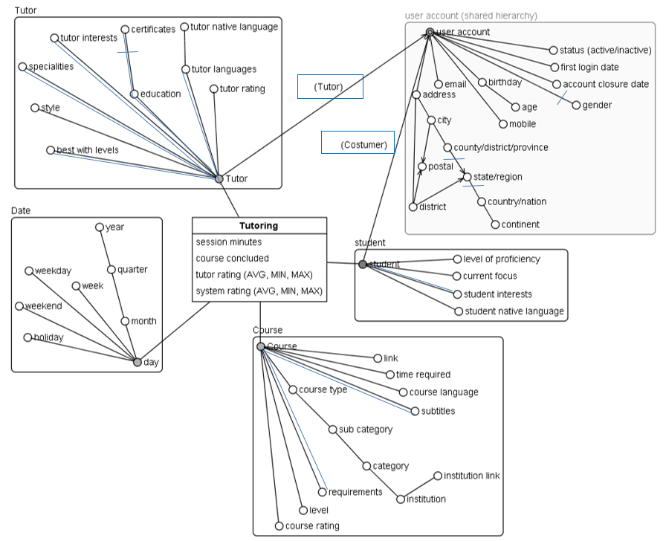
Conceptual DFM Tutoring Fact

Slide 12
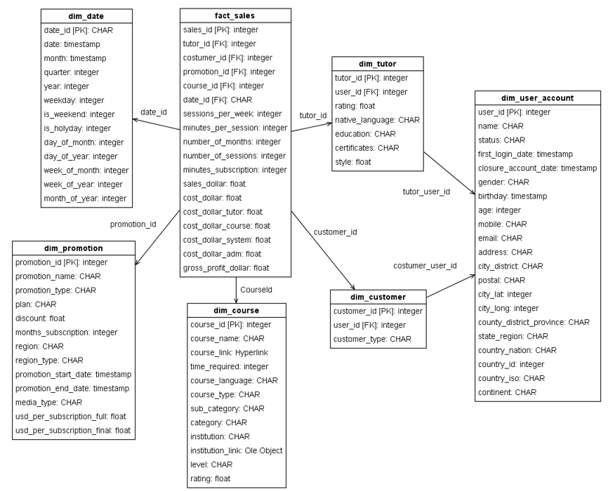
Logical Design Sales Fact

Slide 13
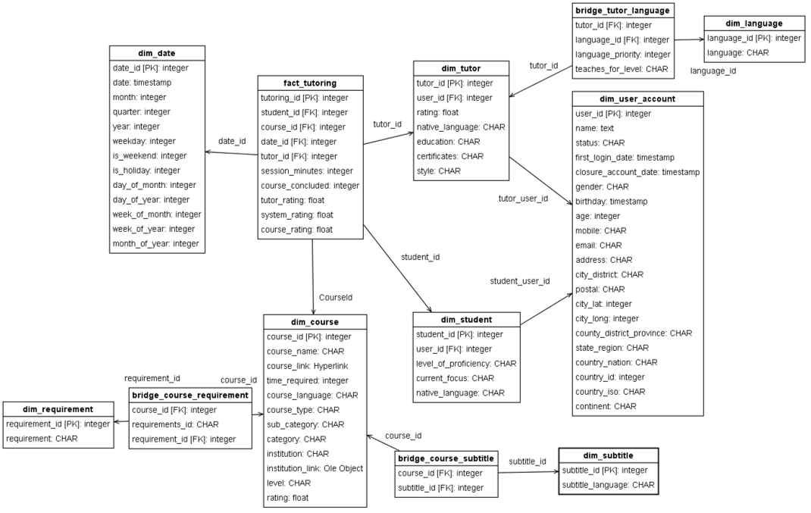
Logical Design Tutoring Fact

Slide 14
Implementation
Data Extraction, Transformation and Load
Pentaho
Create tables
SQL Scripts
Dimensions and Facts
Generate data
Dataset search +
Data generation based on formulas and algorithms
Excel and Csv files
Import file
directly into Pgadmin
Data type and format consistent with the script
(special attention to fields with dates)
Primary keys (no duplicates, not null)
Foreign keys (existing data in the source tables)P
Replacing wrong characters
standardization and correction of data.

Slide 15
SQL Scripts
Examples
Course Sales
CREATE TABLE public.fact_sales
( sales_id BIGINT
, date_id BIGINT PRECISION
, customer_id BIGINT PRECISION
, promotion_id BIGINT PRECISION
, course_id BIGINT PRECISION
, tutor_id BIGINT PRECISION
, minutes_subscribed INTEGER
, sales_dollar DOUBLE PRECISION
, cost_dollar DOUBLE PRECISION
, gross_profit_dollar_amount DOUBLE PRECISION
, CONSTRAINT sales_id PRIMARY KEY (sales_id)
, CONSTRAINT costumer_id FOREIGN KEY (customer_id)
REFERENCES public.dim_customer (customer_id) MATCH SIMPLE
, CONSTRAINT course_id FOREIGN KEY (course_id)
REFERENCES public.dim_course (course_id) MATCH SIMPLE
, CONSTRAINT date_id FOREIGN KEY (date_id)
REFERENCES public.dim_date (date_id) MATCH SIMPLE
, CONSTRAINT promotion_id FOREIGN KEY (promotion_id)
REFERENCES public. dim_promotion (promotion_id) MATCH SIMPLE
, CONSTRAINT tutor_id FOREIGN KEY (tutor_id)
REFERENCES public. dim_tutor (tutor_id) MATCH SIMPLE
);
CREATE TABLE public.dim_course
( course_id BIGSERIAL
, course_name VARCHAR(132)
, course_type VARCHAR(14)
, time_required NUMERIC(97, -1)
, course_language VARCHAR(22)
, course_subtitles VARCHAR(271)
, course_skills VARCHAR(148)
, course_rating BIGINT
, category VARCHAR(32)
, sub_category VARCHAR(40)
, course_level VARCHAR(115)
)
ALTER TABLE public.dim_course ADD PRIMARY KEY (course_id)
;

Slide 16
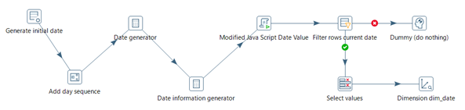
Data Loading ETL
Course
Date

Slide 17
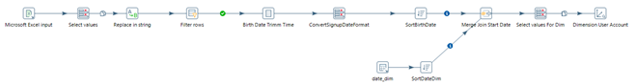
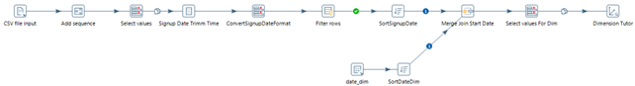
Data Loading ETL
User Account
Tutor

Slide 18

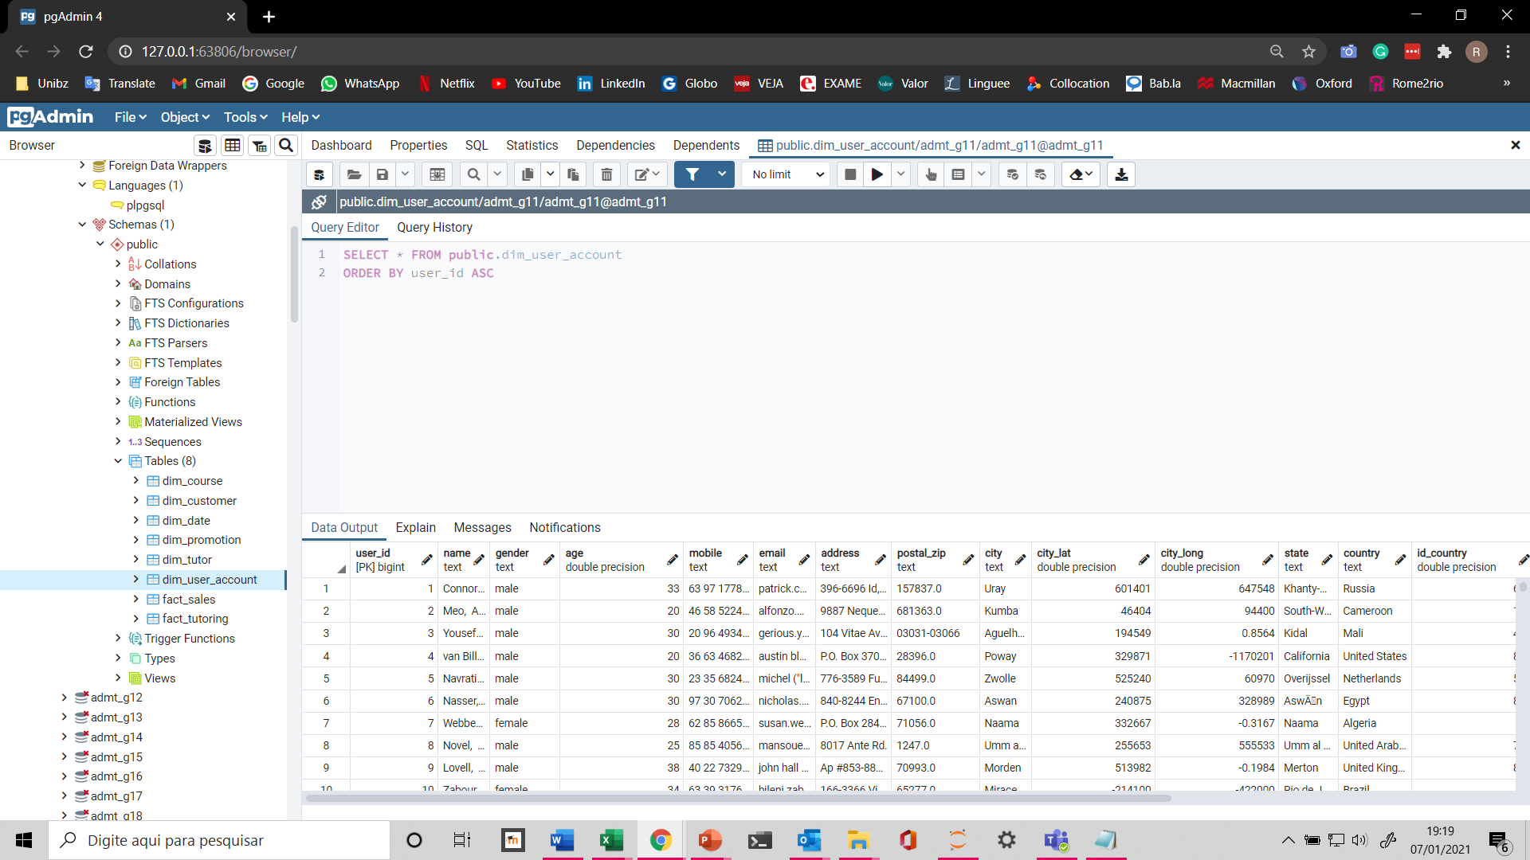
PgAdmin4

Slide 19
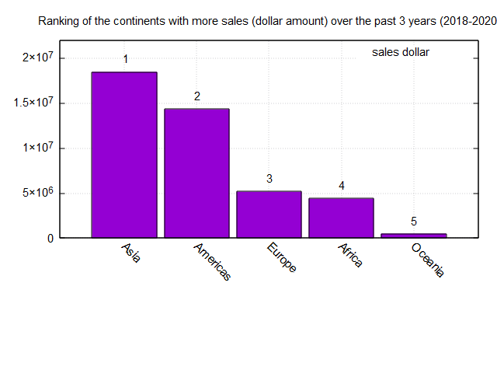
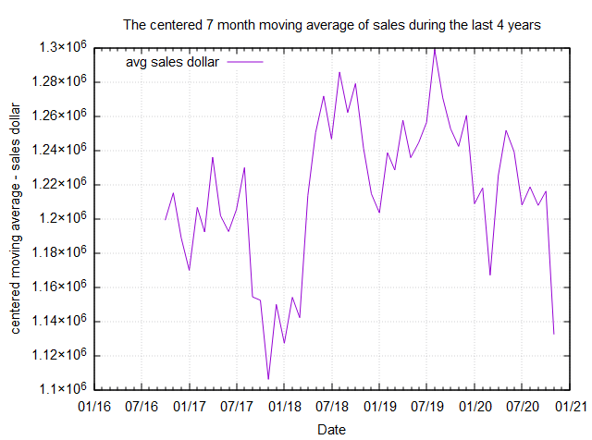
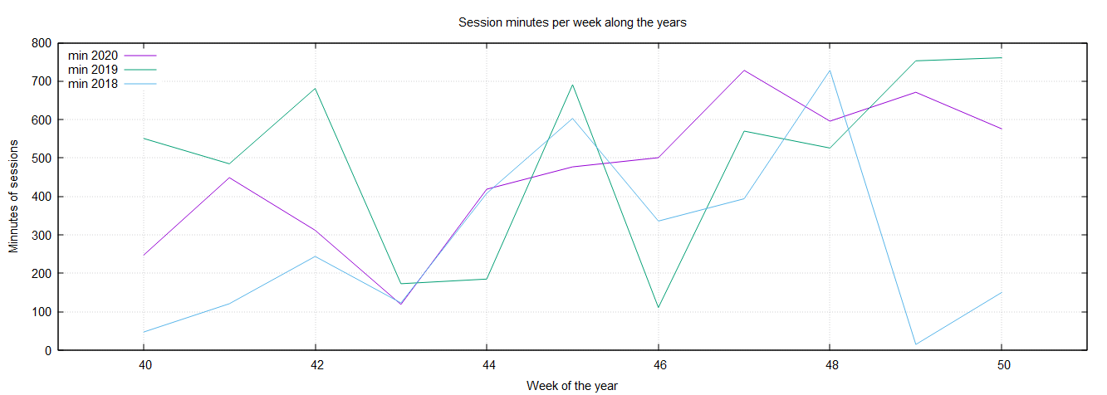
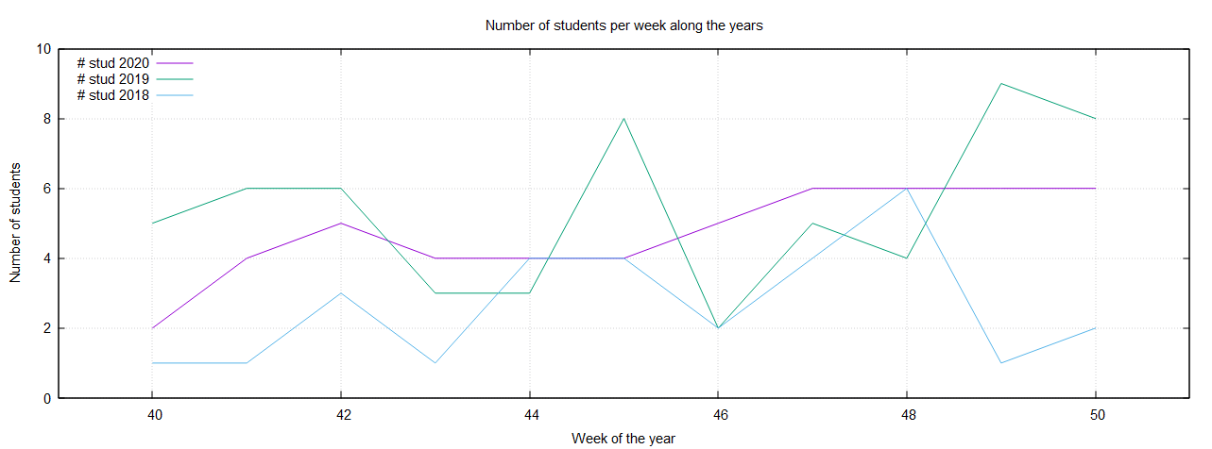
Queries
Graph tool: Gnuplot
ROLLUP
CUBE
GROUPING SETS
GROUP BY extensions:
Ranking and percentiles
Reporting and Windowing
Analytic functions:

Slide 20
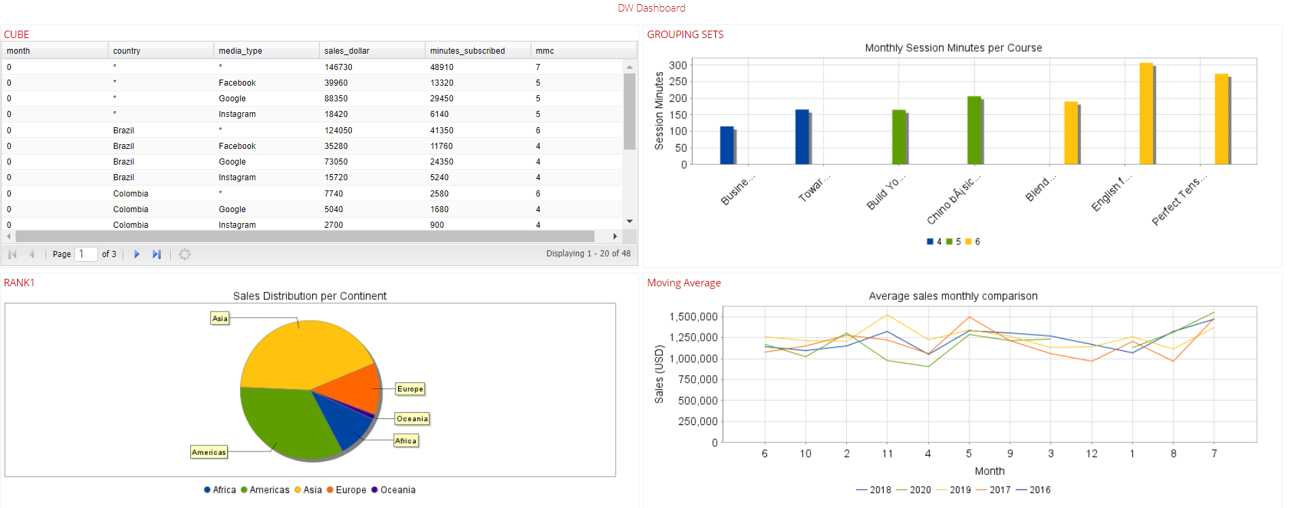
Data Analyses Tool
Queries on a real time dashboard
Pentahoo

Slide 21

Thanks! Questions?

